Slide 1
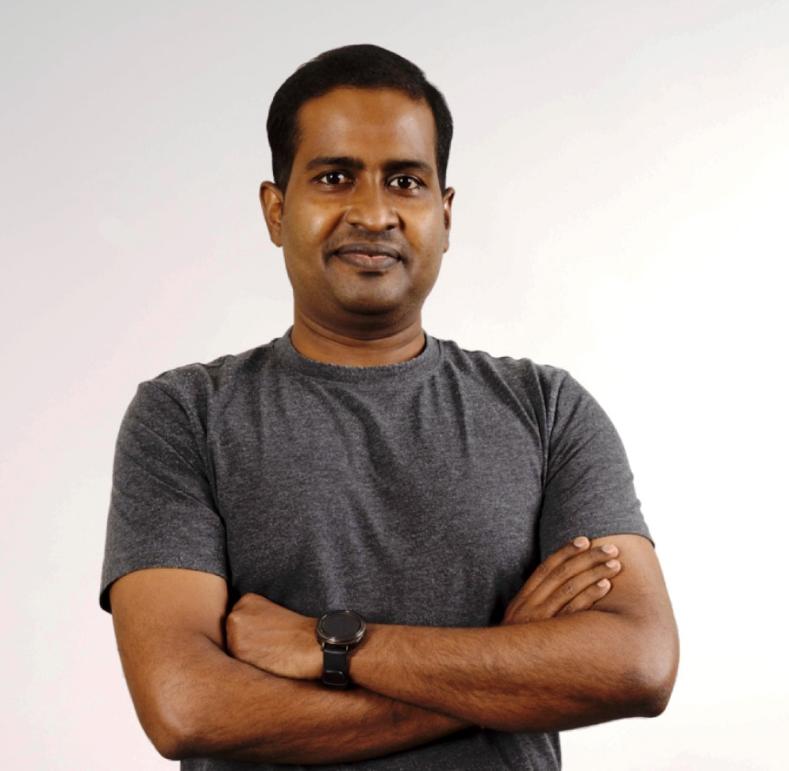

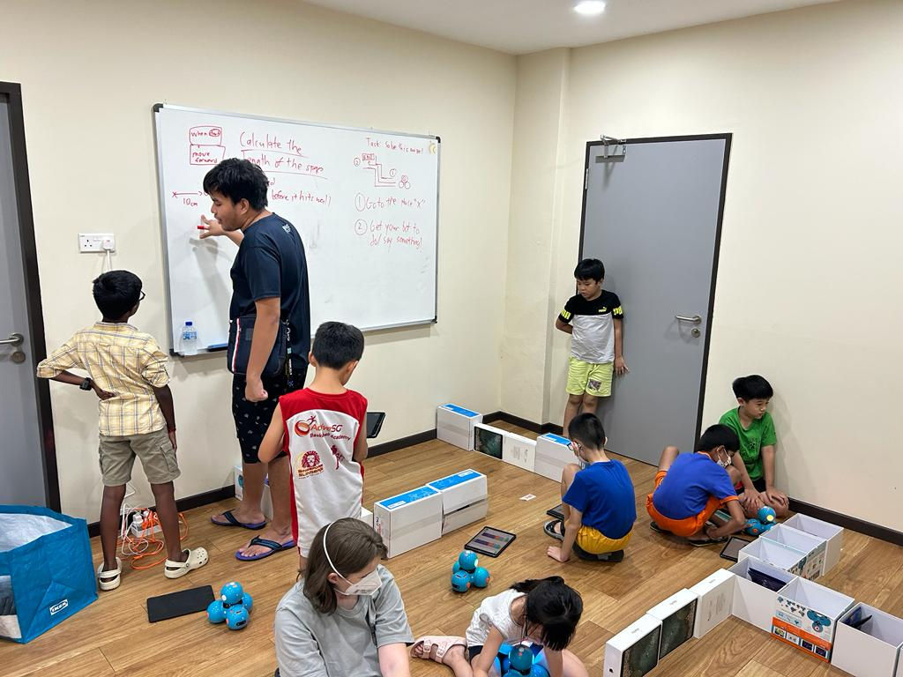
Prabhu NATARAJAN
SENIOR LECTURER
COM3 – 02 – 34
prabhu.n@nus.edu.sg
Ph.D. from School of Computing, NUS
Joined as a lecturer in SoC in 2021
Deputy Director for CCSGP Center
Modules taught in SoC: IT1244, CS2100 & CS2106
Before joining NUS, I was teaching in DigiPen Institute of Technology Singapore
Community Engagements
STEER Sailing Trip

Slide 2
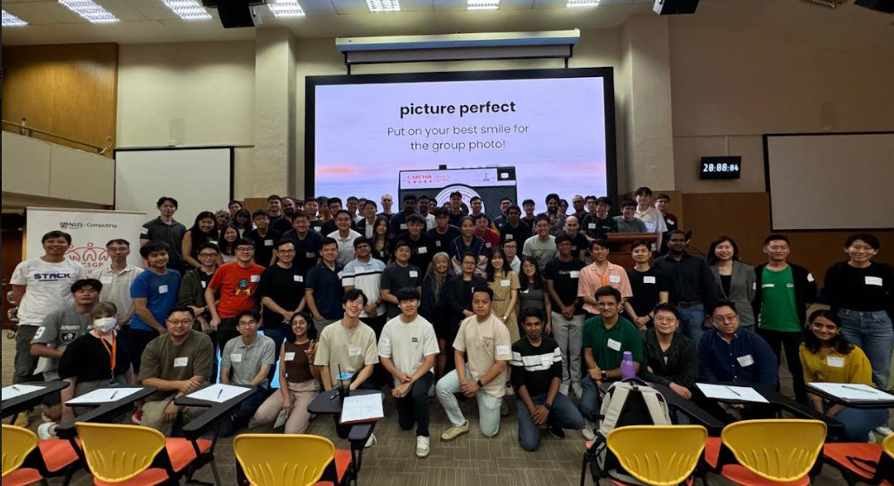
Mentorship Programme

Slide 3
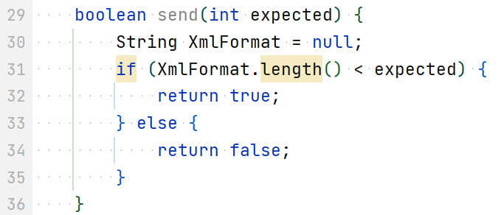
Week 3 → 4
CS2103/T [Aug, 2024]
[50 minutes]
send -> isSend, hasSend, …
XmlFormat is PascalCase. Should be camelCase (i.e., xmlFormat)
Which lines have coding standard violations?
Causes NPE?
return xmlFormat.length() < expected;

Slide 4
Code quality vs coding standard
Code quality guidelines
Follow a
coding standard (aka style guide) (aka conventions)
subjective vs objective

Slide 5

Which one is which?
Answer this question in Week 4 Quiz (on Canvas)
Q
1
merge rebase squash
original
(a)
(b)
(c)
4
6
3
5
5
5
4
5
4
3
3+4
3
2
? force-push
2
2
2
1
1
1
The answer is auto-saved. Don’t submit the quiz yet!
1
? force-push

Slide 6

Which commits will remain if you delete branch ?
Q
2
fix1
C3
C4
C5
C6
C7
master
C7
C6
C5
C4
fix1
C3
It is common to delete branches after merging.
C2
Caution: Don’t delete branches in the iP and tP, as grading scripts check for branches
C1

Slide 7

A pedagogy experiment:
Students were divided into two groups:
Group A: given some information to study.
Group B: given the same information to study but were quizzed about related topics before receiving the info.
The two groups were tested for info retention.
Group B did better.
Compared group B’s improvement in retention between,
Sub-group B1: answered the prelim quiz correctly
Sub-group B2: answered the prelim quiz wrongly
NO DIFFERENCE!
Trying is more important than the correctness. When questioned, think/try
We apply this in tutorials!
… should talk too!

Slide 8

It’s a pain. I can do it though. Just soaks up a lot of valuable time.
Don’t know how to do it
, no sweat
Our aim:
(we need this to achieve fluency, competency)
(let’s make at least some progress in this direction)
Image credit https://www.peoplematters.in/
Notes:
See the printed slide
So many things in this course – git, pull, commit, push, etc. We know your are trying to learn these tools first time and its not easy.
You have to repeat this multiple times, which will be like a pain initially, but later after repeated practice, you will be better.

Slide 9
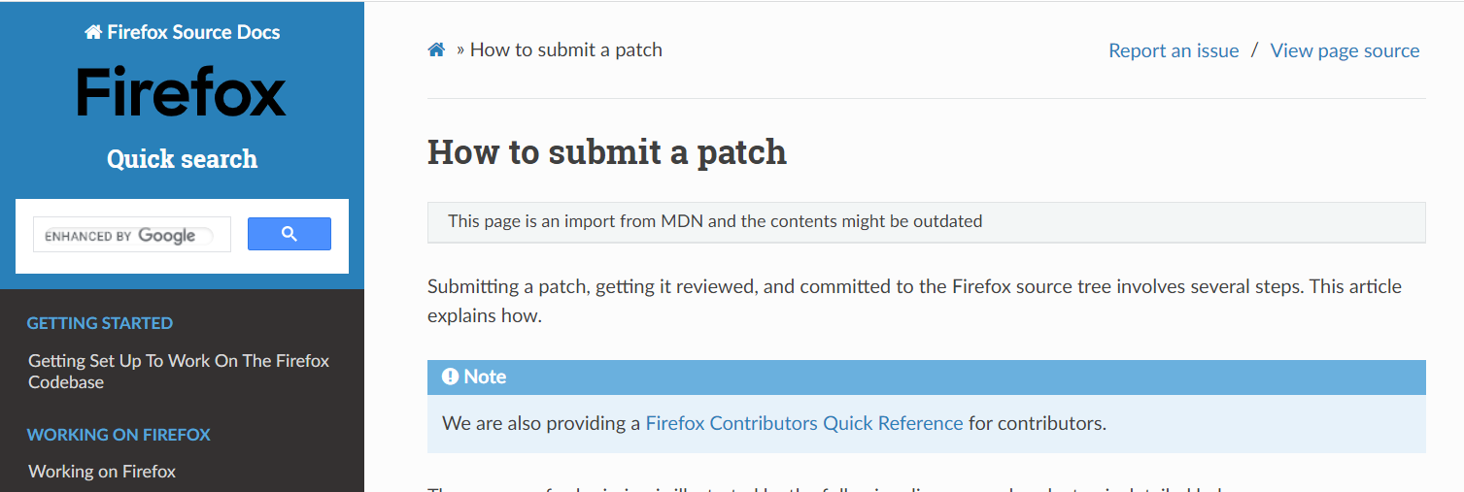
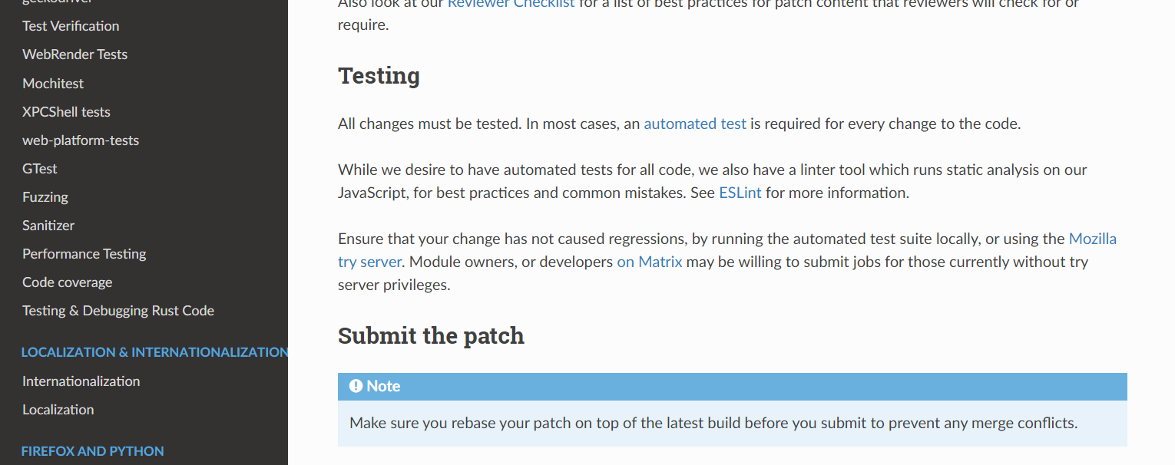
[extra] Mozilla patch policy
An alternative to Pull Requests.
Git can create a file (called a patch) describing your proposed changes. Git can also ‘apply’ the patch file to another repo, to add your changes to that repo.

Slide 10
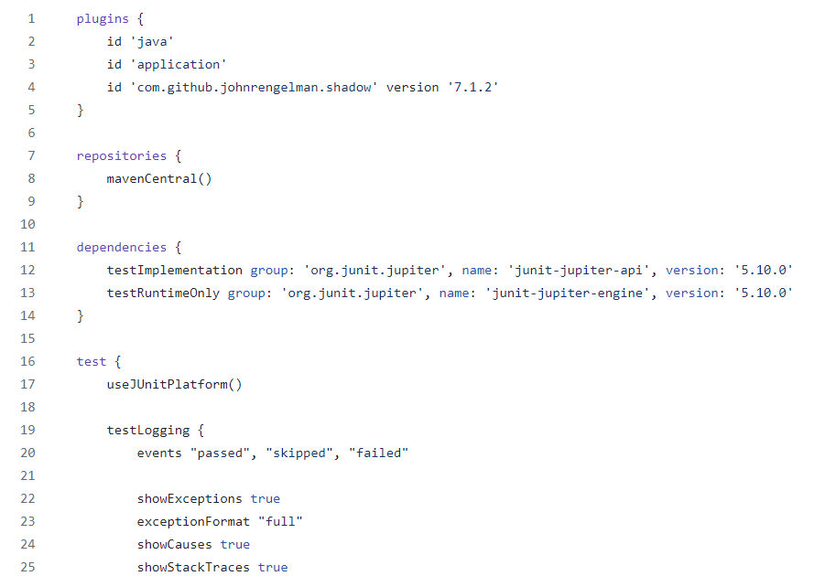


Gradle can manage dependencies too!
Gradle is used for dependency management too

Slide 11
Week 3→4 Briefing Structure
Recap of Week 3
+
Preview of Week 4

Slide 12


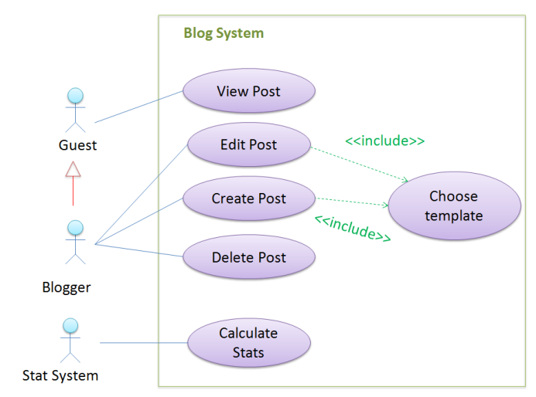
Q
3
What word is common to all three?
forward
diagram
model
person
Notes:
Poll Title: What word is common to all three? https://www.polleverywhere.com/free_text_polls/FVHmj72Se36E1qleFLSyi

Slide 13
models
What word is common to all three?
[… are representations of something else]

Slide 14
models
What is common?
[… are representations of something else]

Slide 15

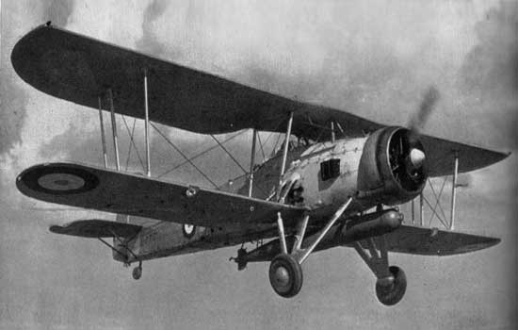



models
… are not the real thing!

Slide 16
models
… are simpler than the real thing!

Slide 17
models

Slide 18
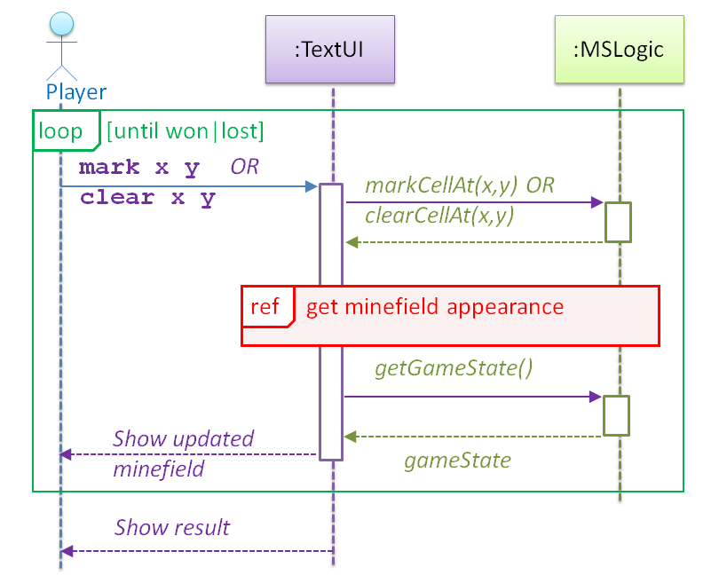
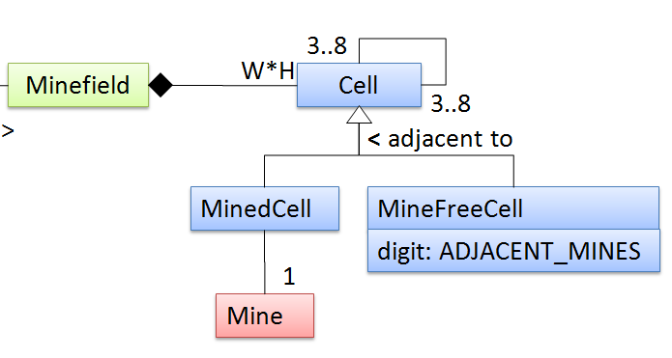

models
… capture different aspects

Slide 19


models
… combat complexity

Slide 20
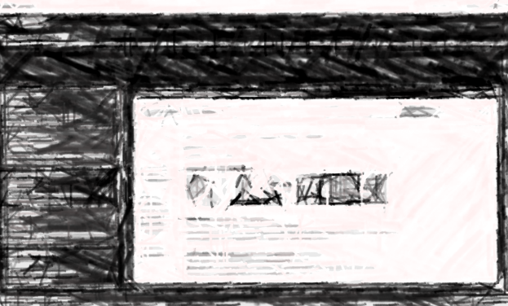


models
Small projects: can generate a mental model on demand
bigger roles in
… are indispensable for bigger projects

Slide 21
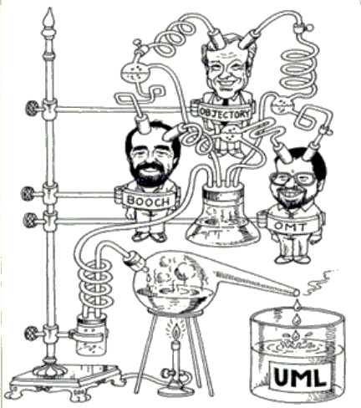
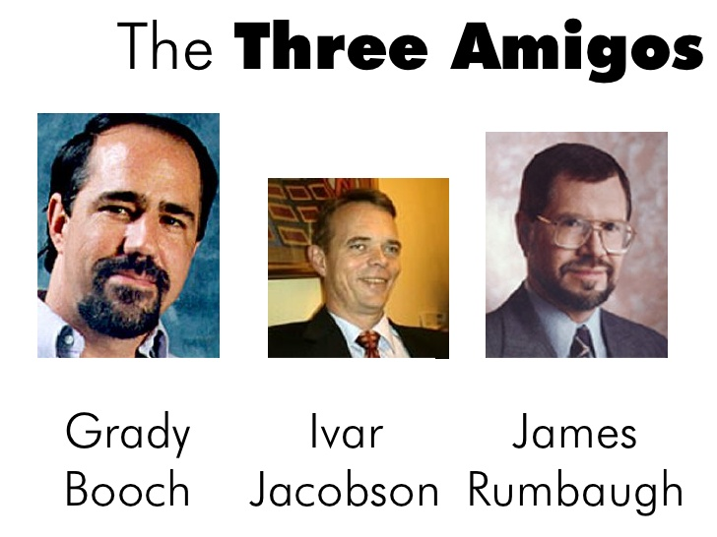
UML (Unified Modeling Language)
Grady Booch
Ivar Jacobson
James Rumbaugh

Slide 22

UML creators are also known as …
Q
4
The gang of four
The order of the white lotus
The three amigos
Spice boys
Grady Booch
Ivar Jacobson
James Rumbaugh

Slide 23
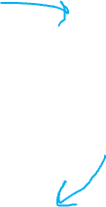
models
for what?
i. for analysis
ii. for communication
iii. as a blueprint
Notes:
Poll Title: Models are used in this course mostly for ... https://www.polleverywhere.com/multiple_choice_polls/aNgh2RWk523FHteWJXxPp?display_state=instructions&activity_state=opened&state=opened&onscreen=persist

Slide 24
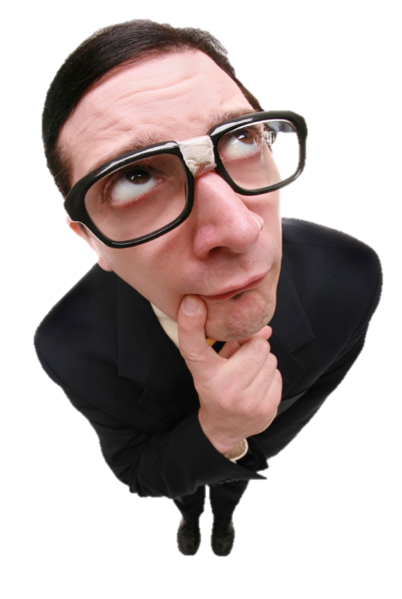

models
for what?
i. for analysis
ii. for communication
Is UML used IRL?
Nope, we don’t use UML diagrams
iii. as a blueprint

Slide 25
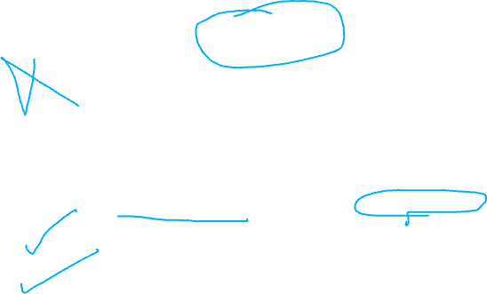
UML
Q
5
[ ] There are better alternatives ? No modeling ? Ad-hoc notations ? Domain-specific models e.g., a modelling notation specifically for finance domain
[ ] Not used a lot in actual practice
[ ] Over-emphasized in this course
The ability to visualize code in some other form (i.e. model code) – UML or other notations – is an essential survival skill.

Slide 26
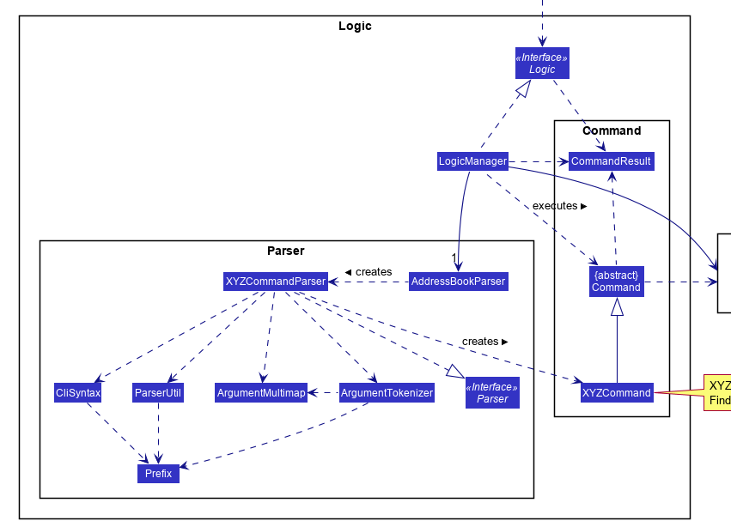
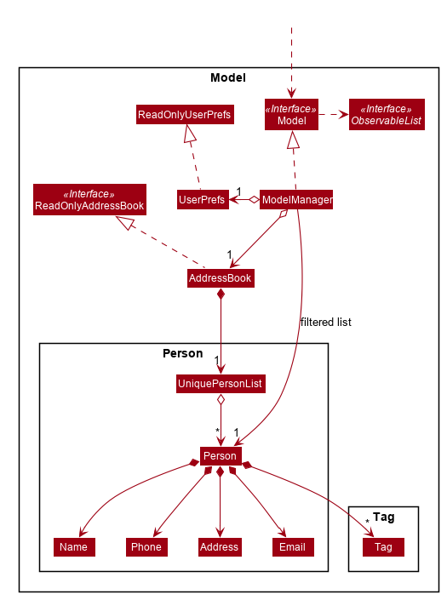
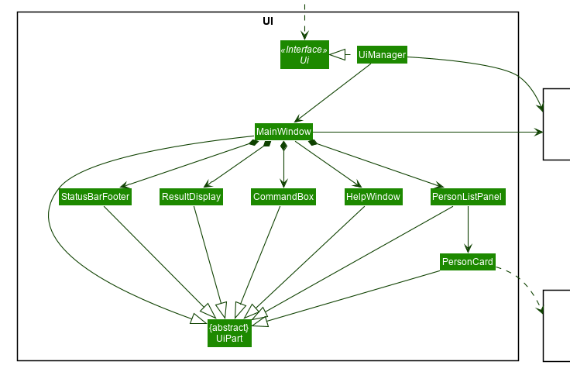
UML
Modeling structure
Modeling behavior
Class structure: class diagrams
Object structure: object diagrams
For the time being, interpreting only!
Diagram → implement code ? Not yet
Code → draw diagram? Not yet

Slide 27
Imagine this scenario in project meeting at the workplace:
Ann: An engineer, college grad
Goes to the whiteboard and …
Betsy: An intern, college student
Derrick: Tech lead/ manager
Charlie: An engineer, self-taught

Slide 28


Slide 29
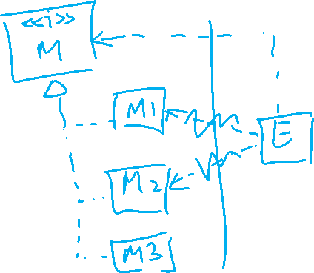

Slide 31
Imagine this scenario in project meeting at the workplace:
Ann: An intern, college grad
- Goes to the whiteboard and …
Betsy: An intern, college student
- “Yes, but that adds another layer of abstraction; is it worth it?”
Derrick: Tech lead/ manager
- Nods in agreement
Charlie: An engineer, self-taught
- Silent

Slide 32
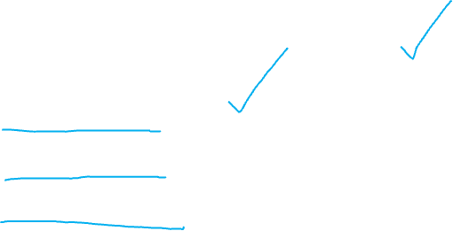
We aim to learn UML usage for …
Q
6
[ ] for sketching to aid discussion
[ ] for documenting
[ ] as blueprints
[ ] for code generation
[ ] for model checking
A formal methods technique that analyzes a model of a system to check whether given properties of a system are satisfied.
What prerequisite topics would you like CS2103 to cover?
CS4211 (Formal Methods for Software Engineering) Prof: I assume they know UML; I often refer to UML diagrams like class/state diagrams.
Notes:
In software development, formal methods are mathematical approaches to solving software (and hardware) problems at the requirements, specification, and design levels

Slide 33
Recommended to watch the videos

Slide 36
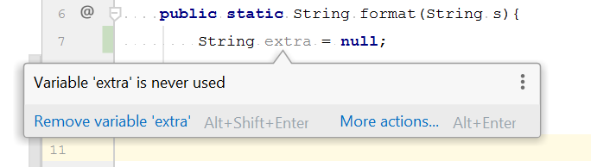

Slide 37

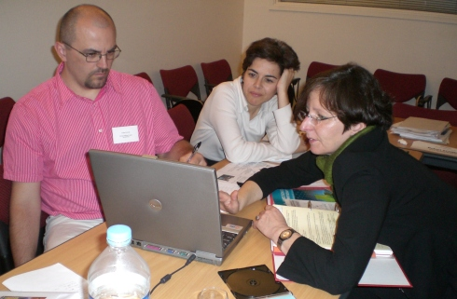

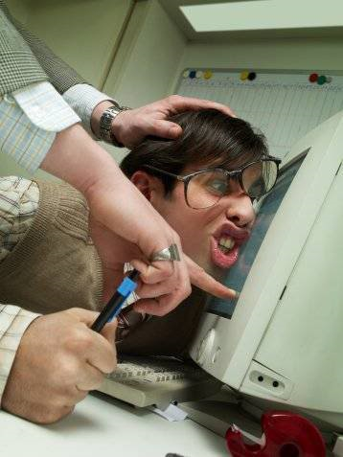
Code reviews

Slide 38
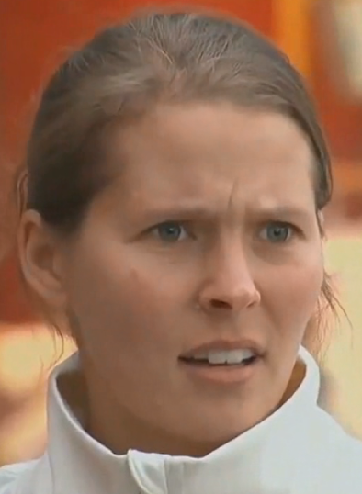
Code reviews

Slide 39

It’s harder to learn the _____ of code reviews
Q
7
( ) mechanics
( ) tools
( ) inter-personal aspects
give constructive feedback, without offending
Receive feedback, without getting offended
Respond to feedback, without getting defensive

Slide 42
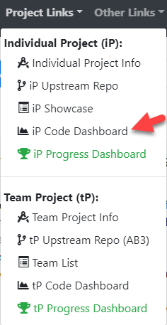
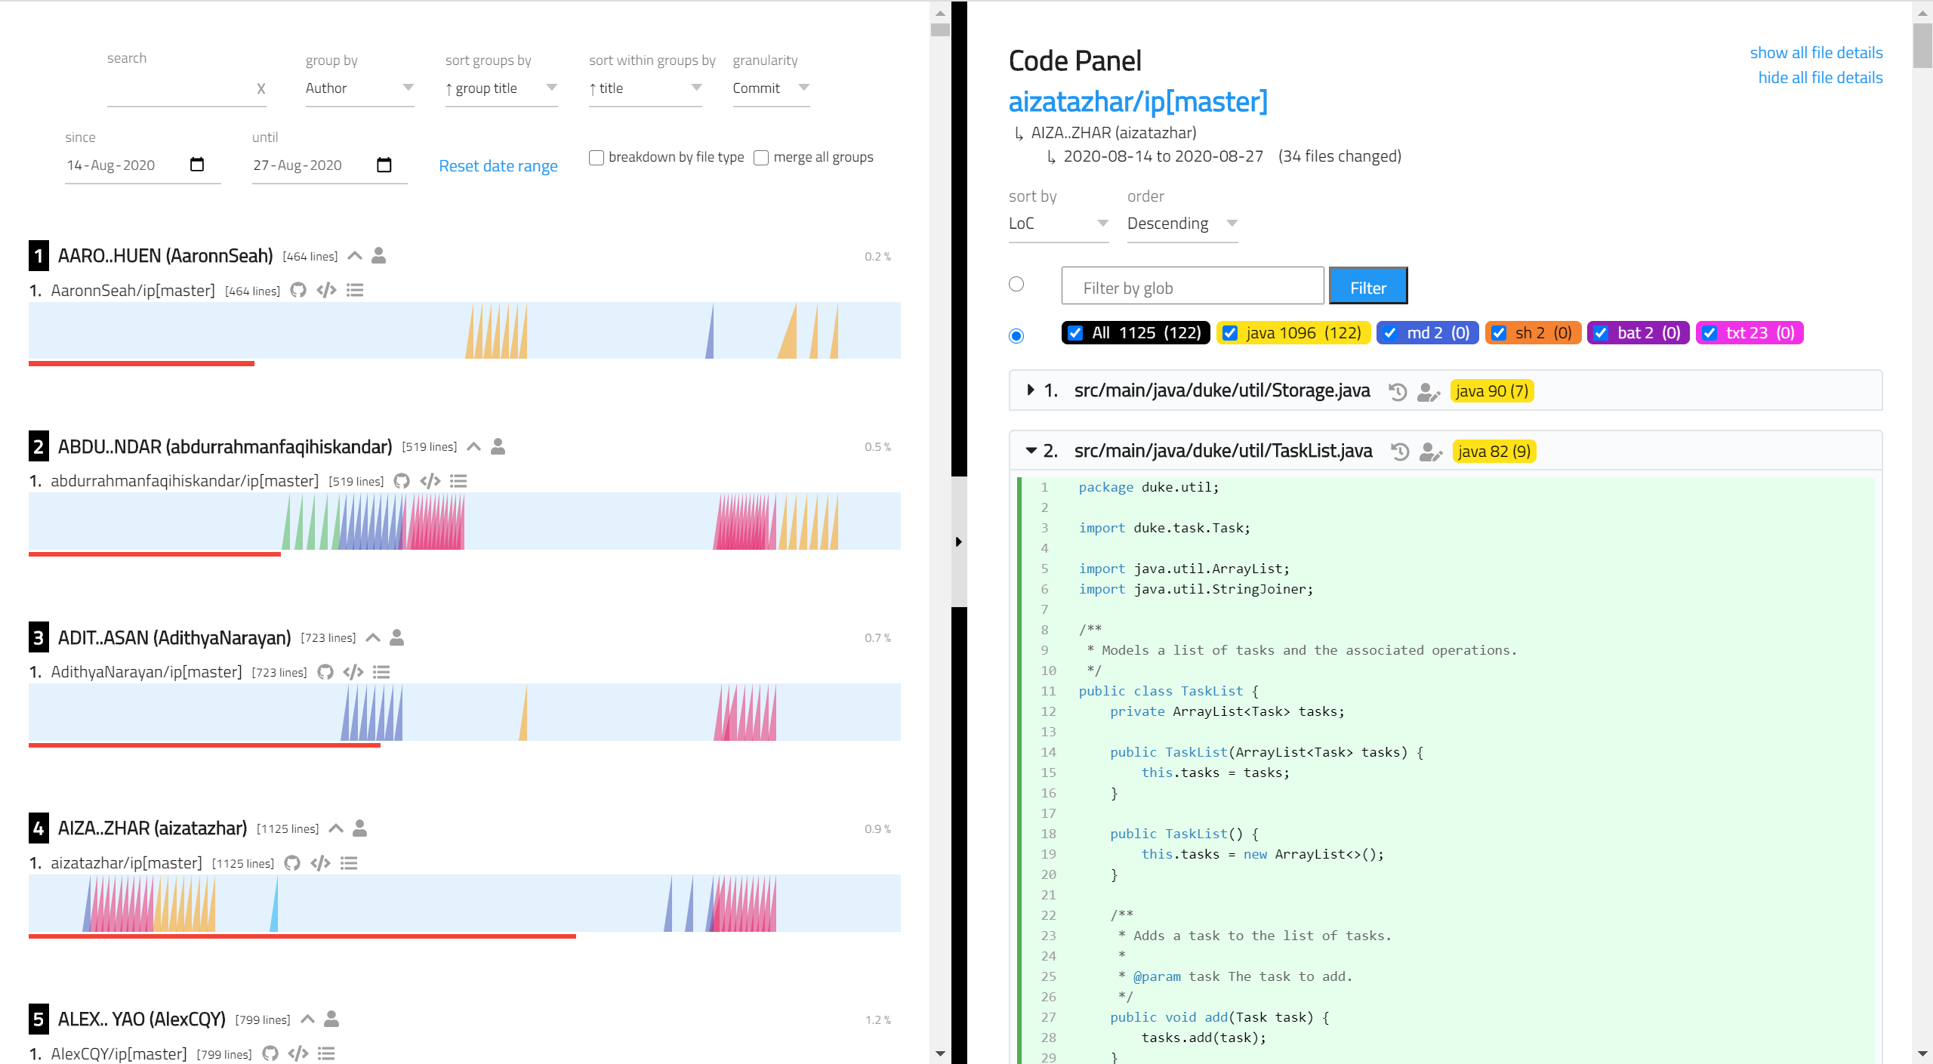
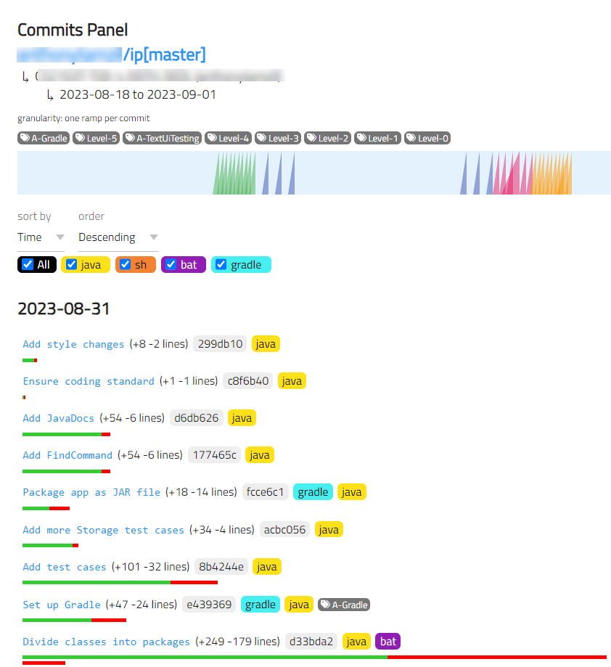
RepoSense code dashboard for the iP

Slide 43

Recommended: ___ look at others’ code
Q
8
( ) Don’t
( ) Please
In this era of AI-assisted coding, reviewing not-your-own code (e.g., code generated by AI) is an even more valuable skill.
[but follow our reuse policies]
[automated plagiarism checks on tP (not iP) code]

Slide 44
Watch the ‘tP – part 1’ course briefing video segment (given in W4 schedule page)

Slide 45
